Slide 1


-Rishit

Slide 2
Description
An animal prediction website, powered by cutting-edge technology and deep learning! This website allows you to upload an image of an animal, and its model will accurately predict the species it belongs to.

Slide 3
Technologies used
Frontend: React and Vite for a fast, responsive user interface.
Backend: Powered by Flask to handle image uploads and predictions.
Deep Learning: The backbone of the prediction system is a Convolutional Neural Network (CNN) trained on a large set of animal images.

Slide 4
How it Works?
Upload Image: Simply select or drag and drop an image of an animal from your device.
Prediction: Once uploaded, our model will analyze the image and predict the species.
Result Displayed: In just a few seconds, the predicted animal species will be shown on your screen.
Your paragraph text

Slide 5



Behind The Scenes
Backend API processes the image and feeds it to the CNN model
Image uploaded on the frontend is sent to the backend
Model predicts the animal and the result is displayed

Slide 6
What is a CNN??

Slide 7
A CNN (Convolutional Neural Network) is a type of deep learning model specifically designed for analyzing visual data, like images. It identifies patterns and features in an image to make predictions.

Slide 8



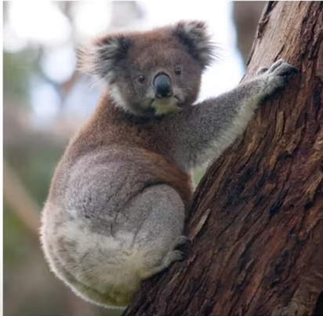

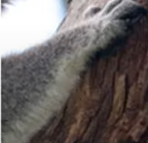
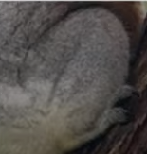
How do we recognize images
Koala Ears : YES
Koala Eyes : YES
Koala Face: YES
Koala Nose : YES
Koala : YES
Koala Hand : YES
Koala Body: YES
Koala Leg : YES

Slide 9
Similarly A cnn model classifies an image by
Breaking the Image into Smaller Pieces
Recognizing Patterns and learning the Features at Multiple Layers
Pooling (Downsampling)
Prediction

Slide 10
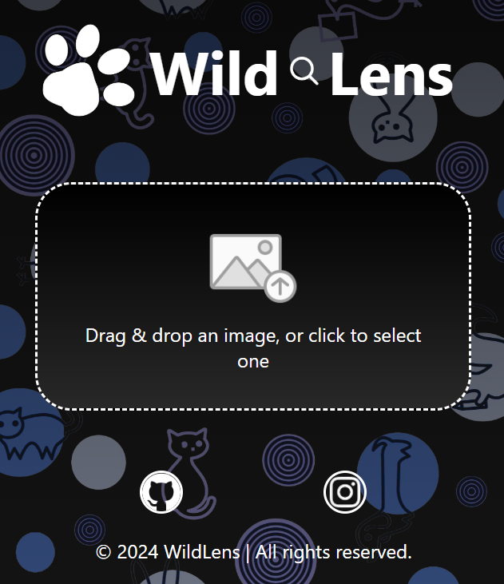
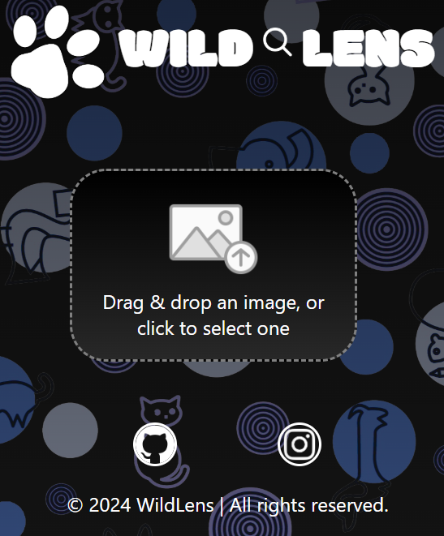

Try it out!!
https://wildlens-tco6.onrender.com/
Website Sample

Slide 11
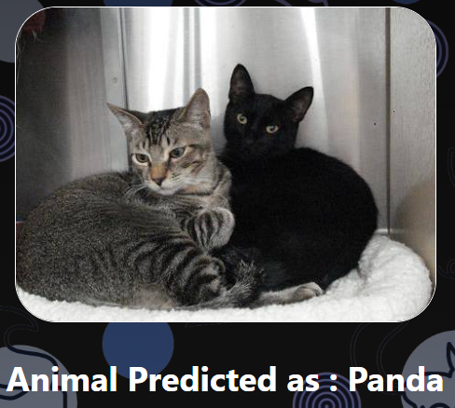
Limitations of the current version
Can only predict 15 animal types
Wrong predictions for certain patterns. For e.g. a black and white pattern will result in a panda

Slide 12
FUture updates
Increasing the number of Animal Classes.
Improving on existing model for higher accuracy and predictions.

Slide 13


